Slide 1

Hotel Booking System
By:
Mohamed Elgamal

Slide 2

Why Hotel Booking System?
Hotel booking system is a valuable tool for any small hotel. It helps manage room availability, automate the booking process, get insights into guests, and improve security.
What did I do to end the system?
- Searching in the beginning.
- Brain Storming on paper.
- Ask some old-volunteers in the committee.
2

Slide 3
Hotel Booking System is consisting of 9 classes
Hotel
Person
Account
Supervisor
Worker
CEO
User
Food
Room
Entertainment
3

Slide 4
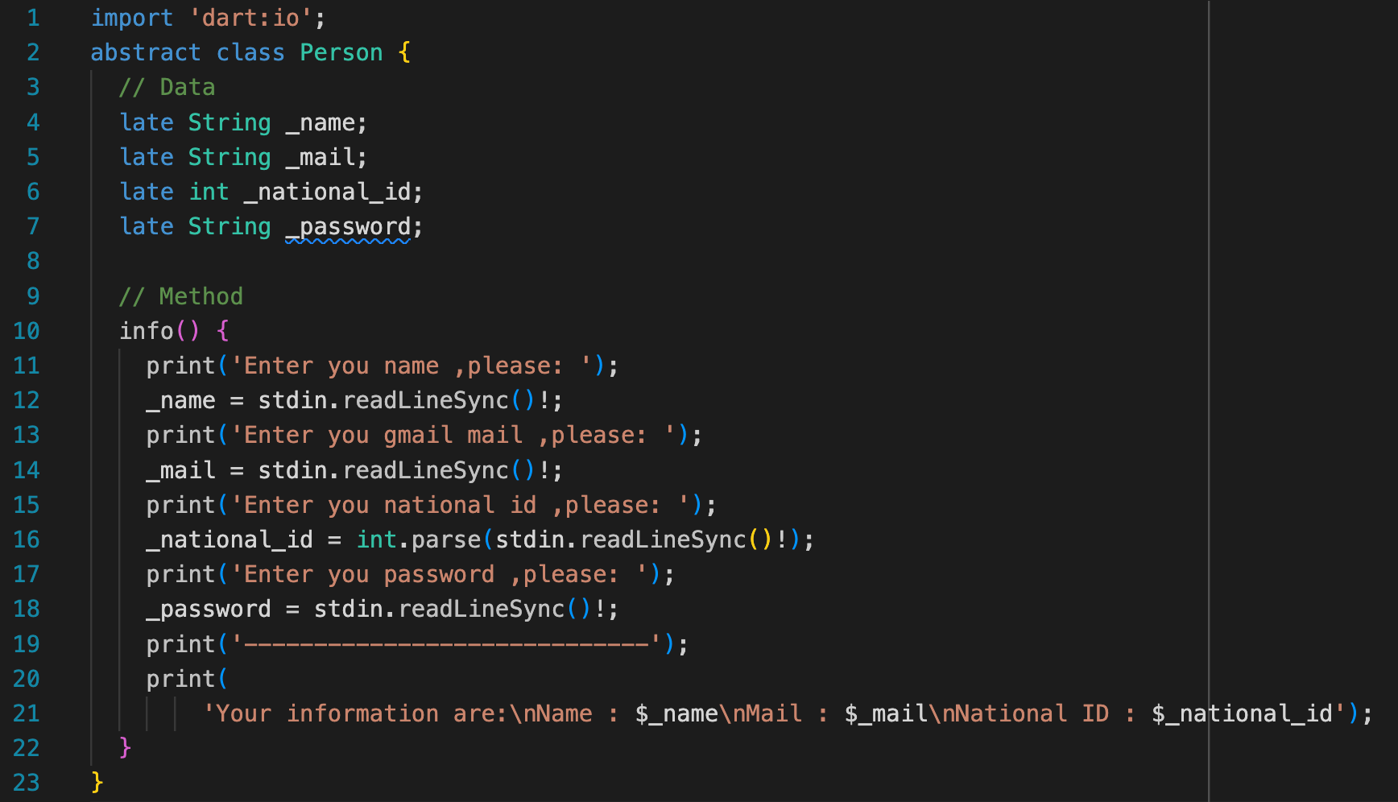

Class Person
4

Slide 5
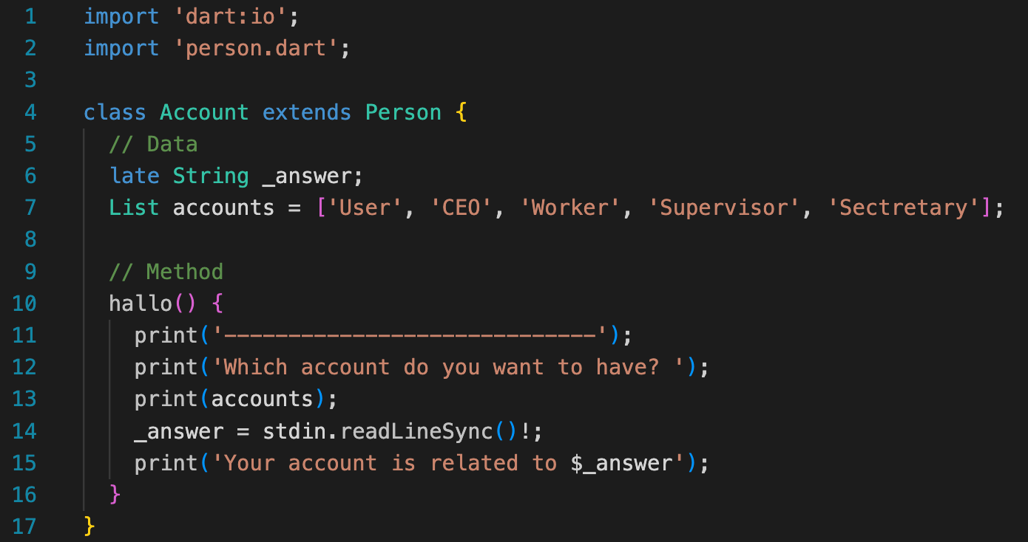
Class Account
5

Slide 6
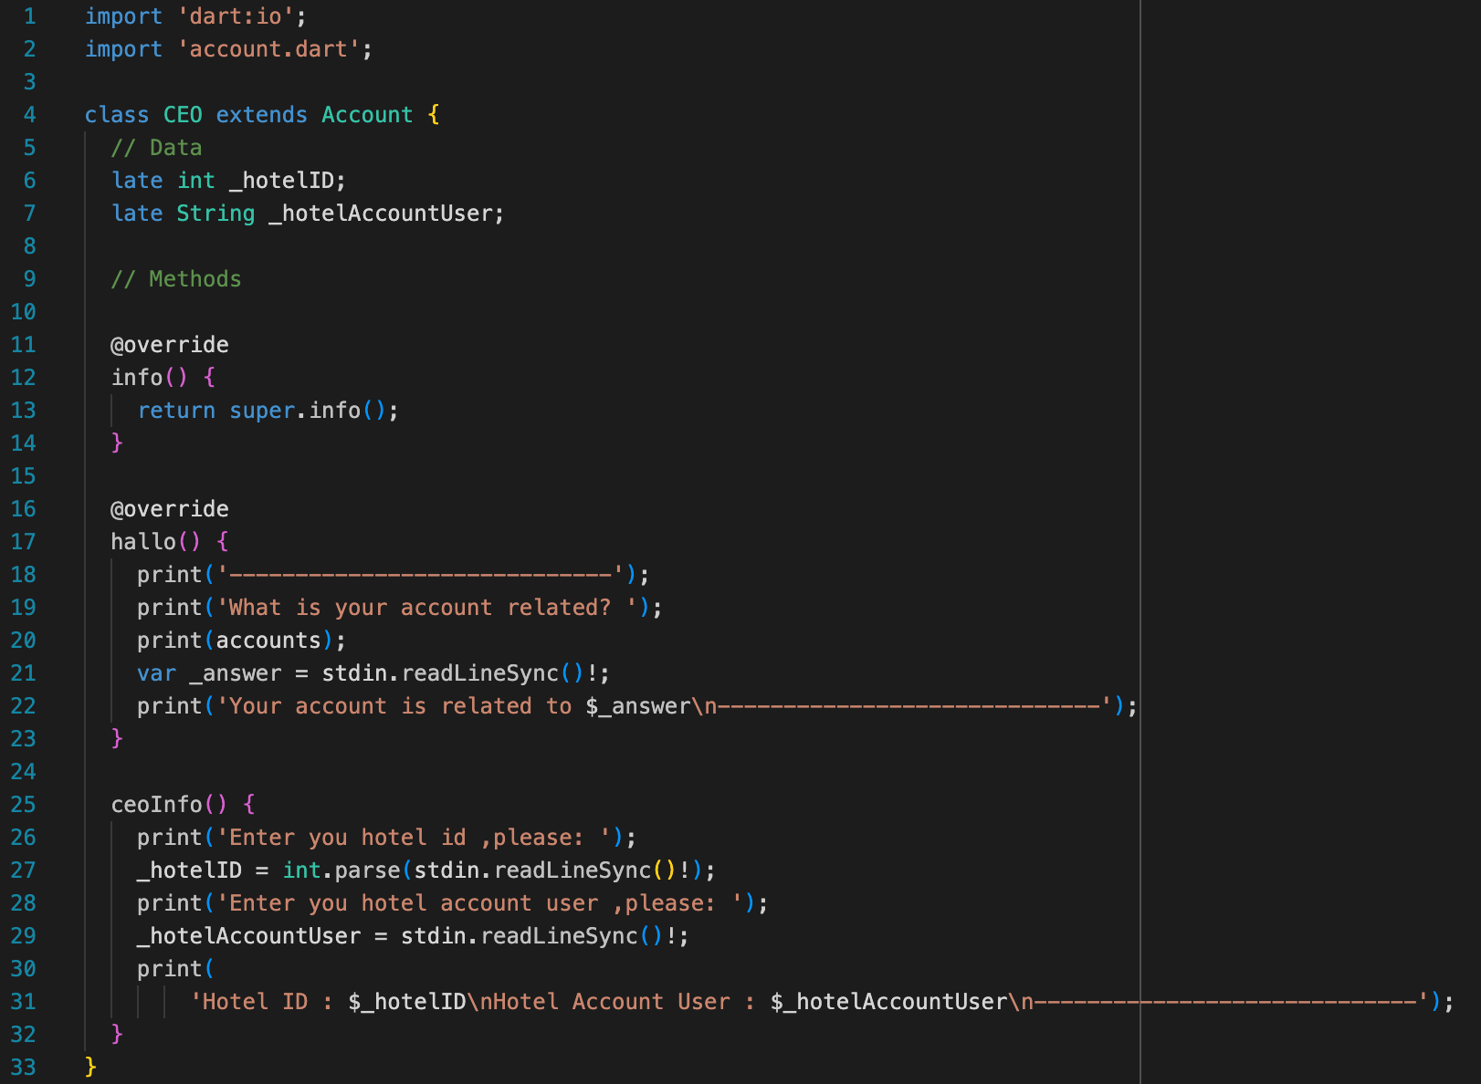

Class CEO
6

Slide 7
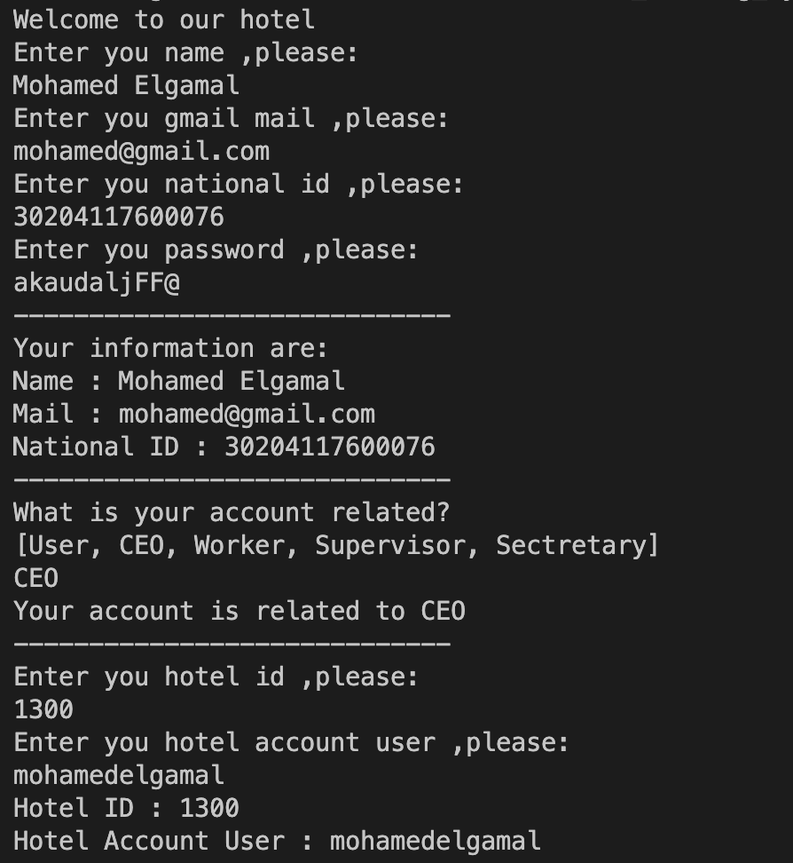
Class CEO Result
7

Slide 8
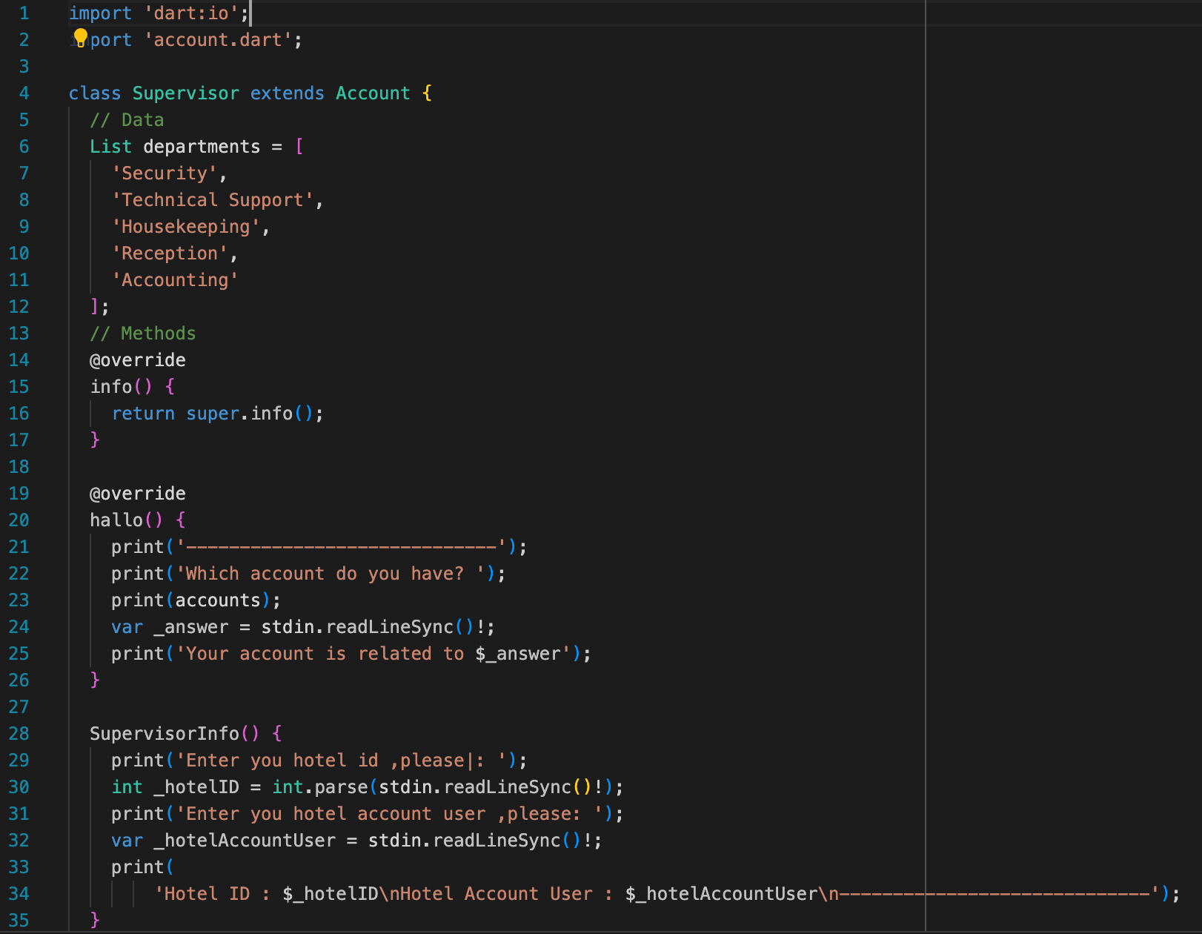

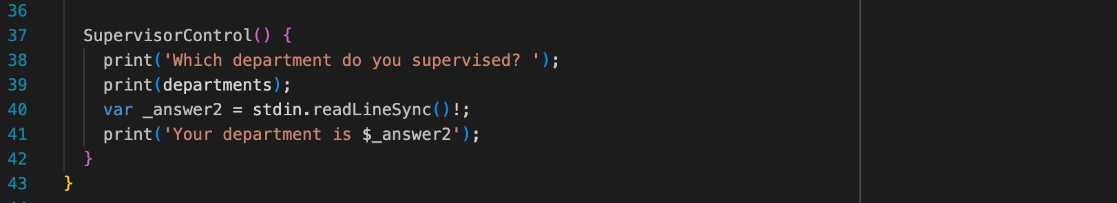
Class Supervisor
8

Slide 9
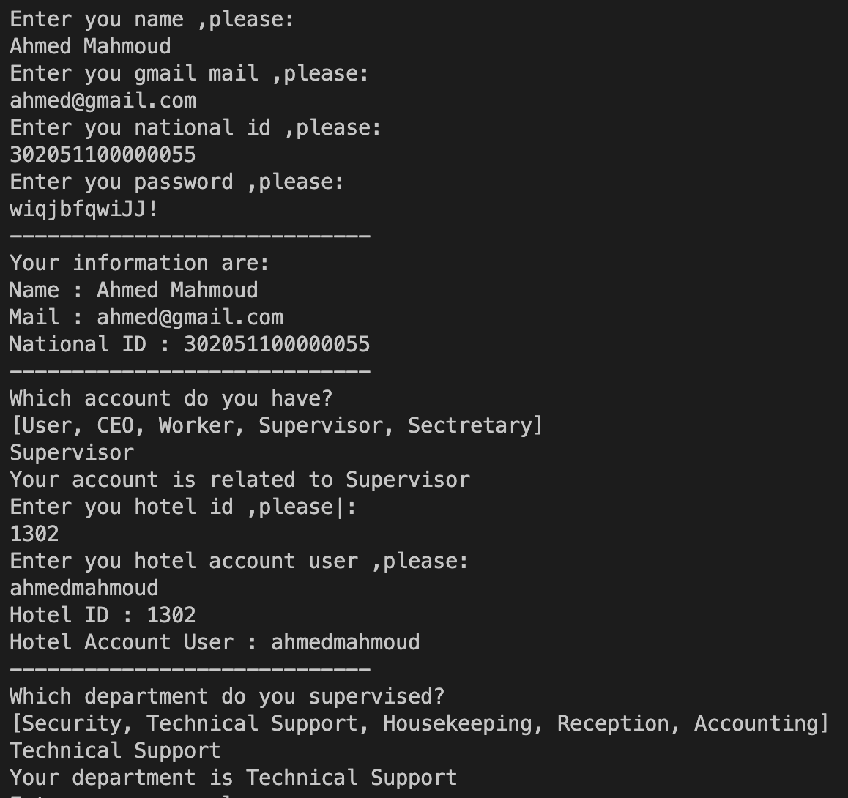
Class Supervisor Result
9

Slide 10
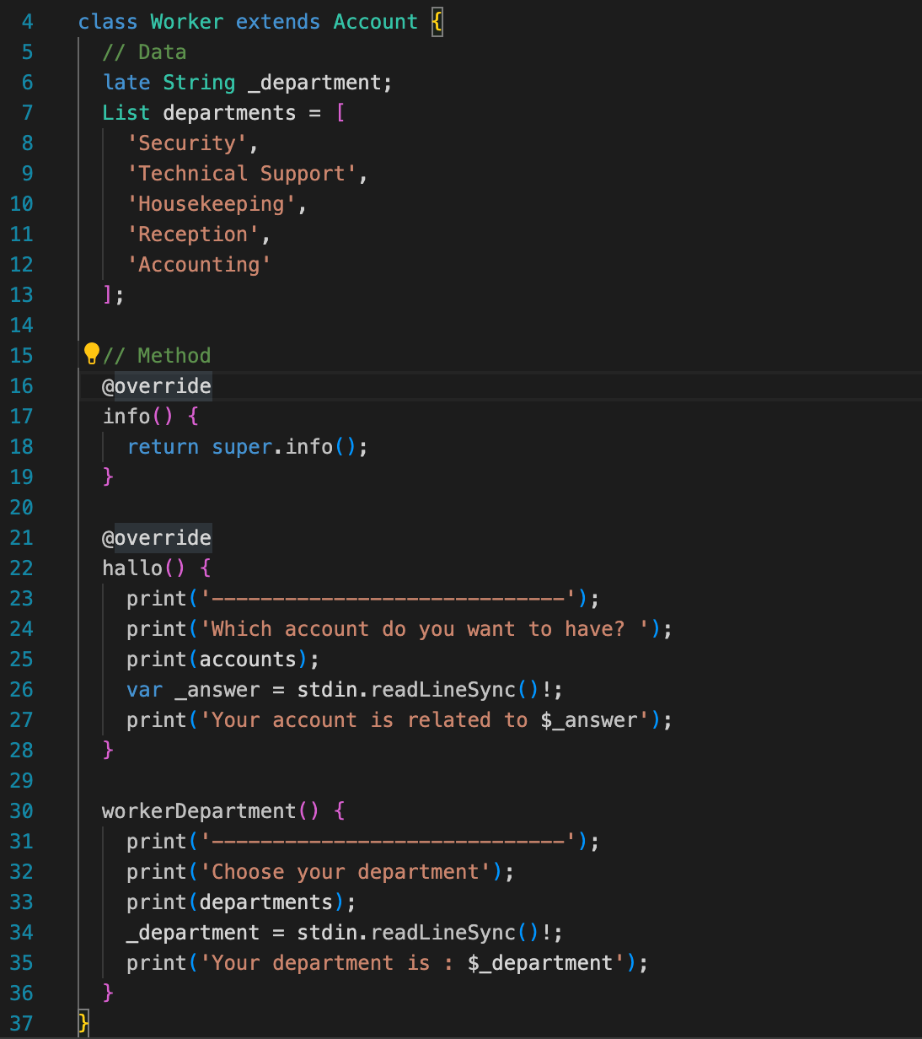



Class Worker
10

Slide 11
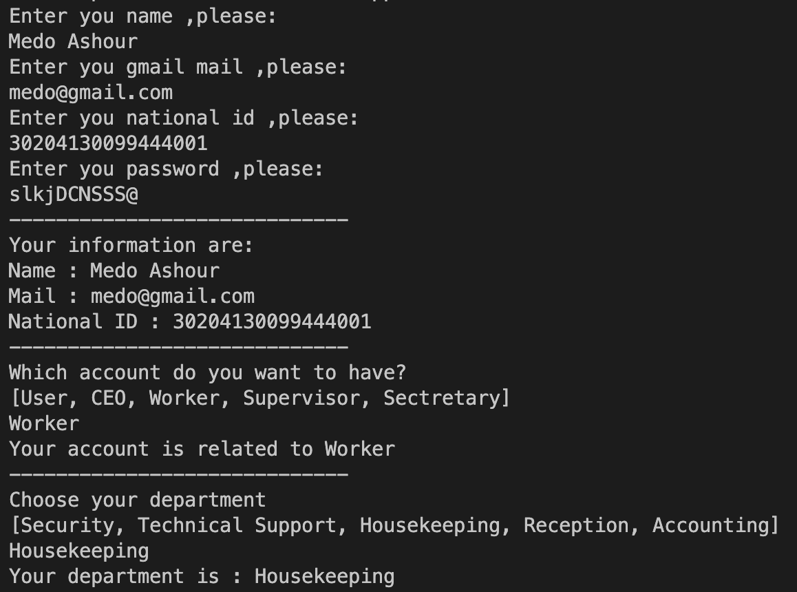
Class Worker Result
11

Slide 12
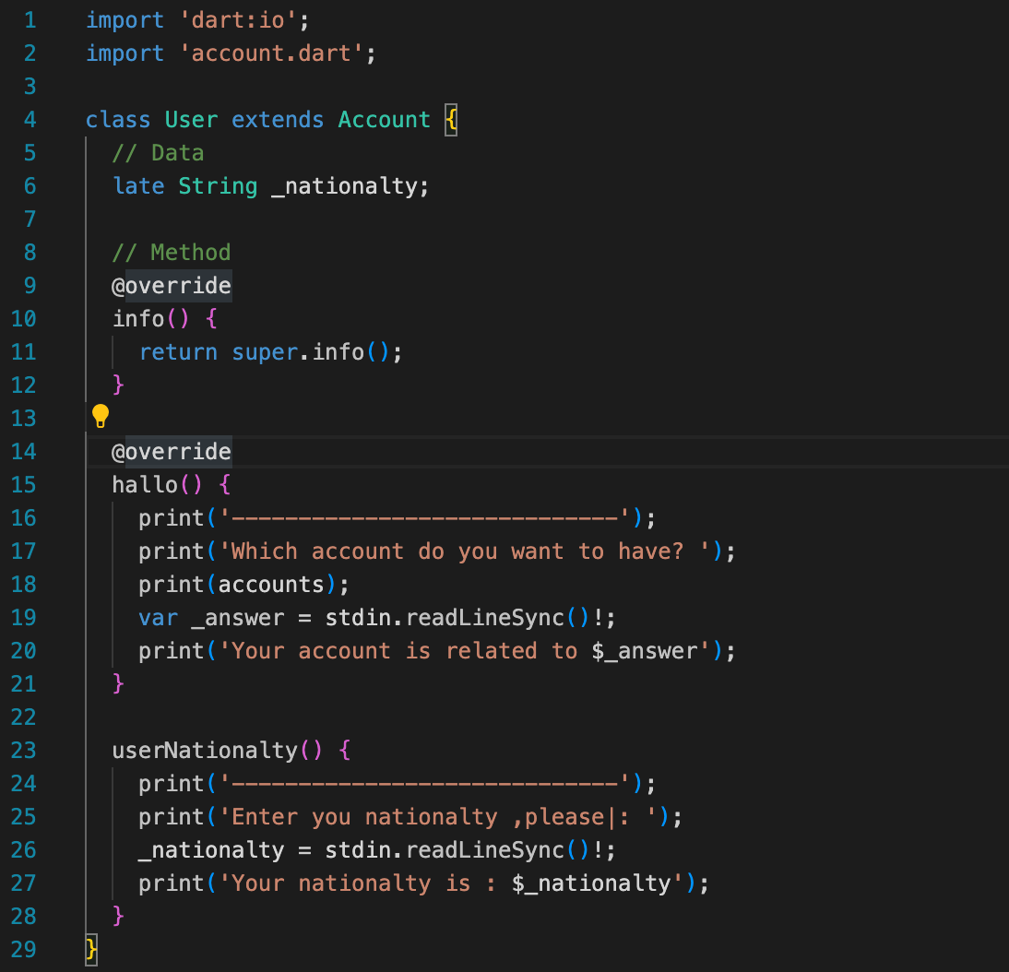
Class User
12

Slide 13
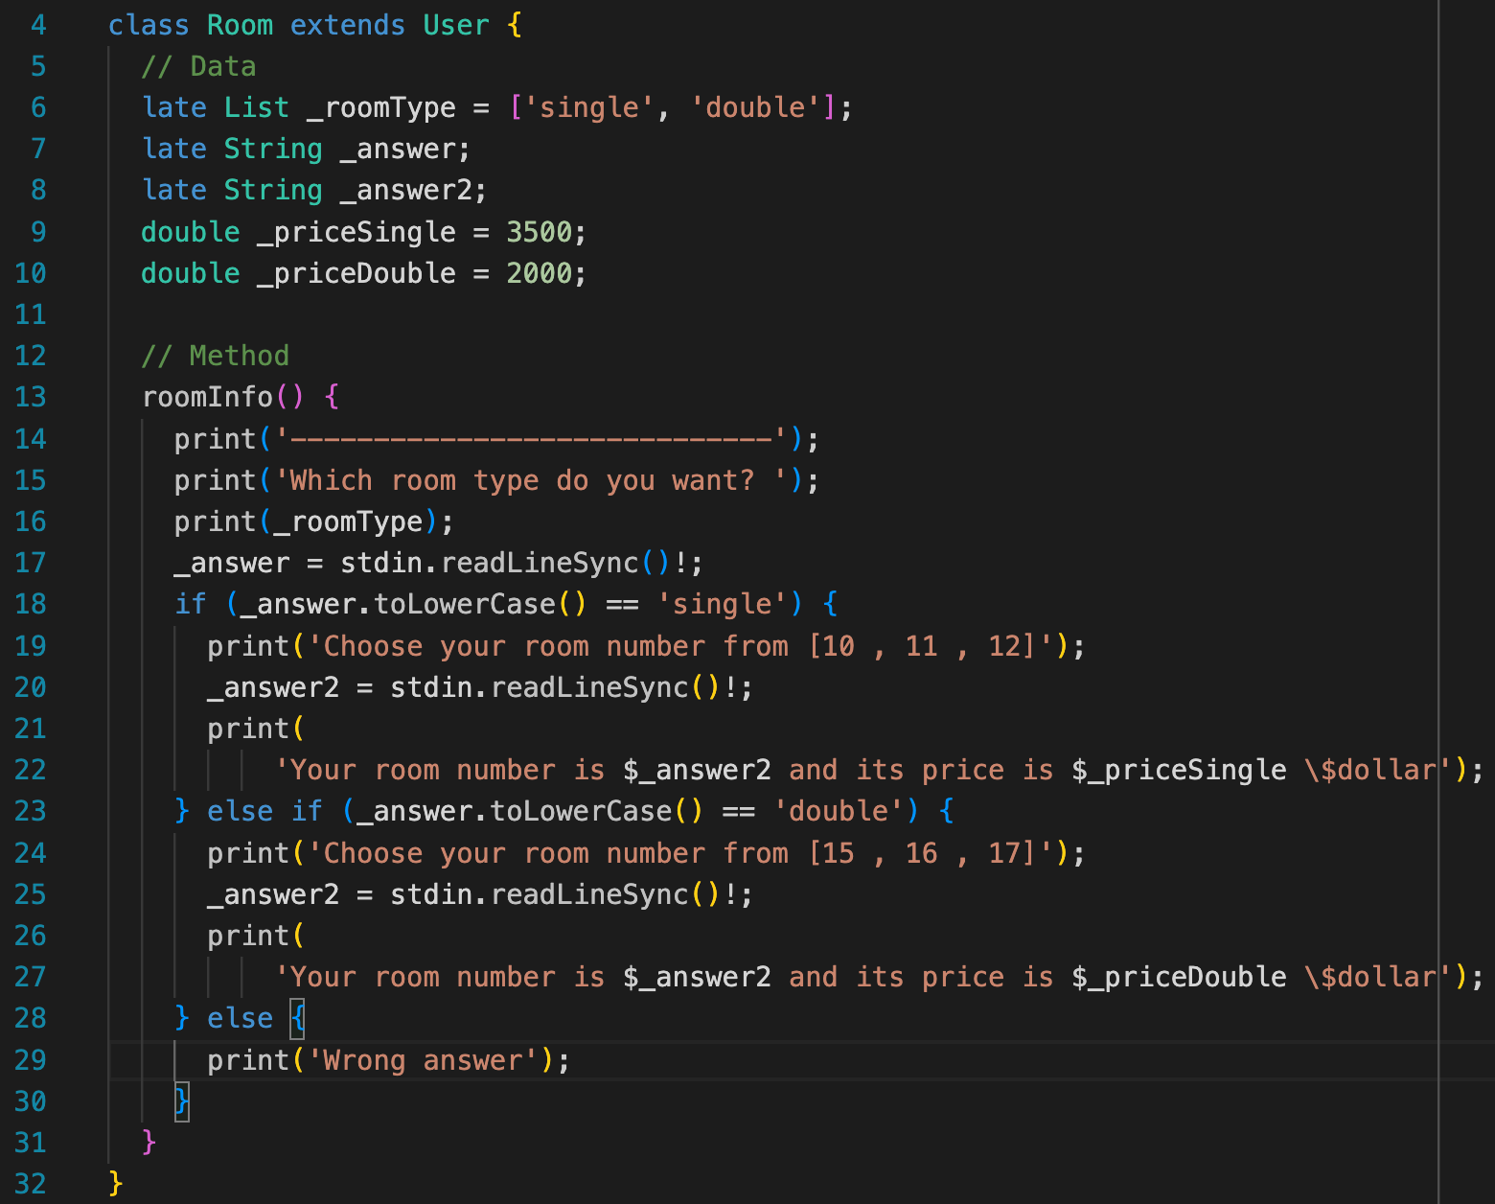

Class Room
13

Slide 14
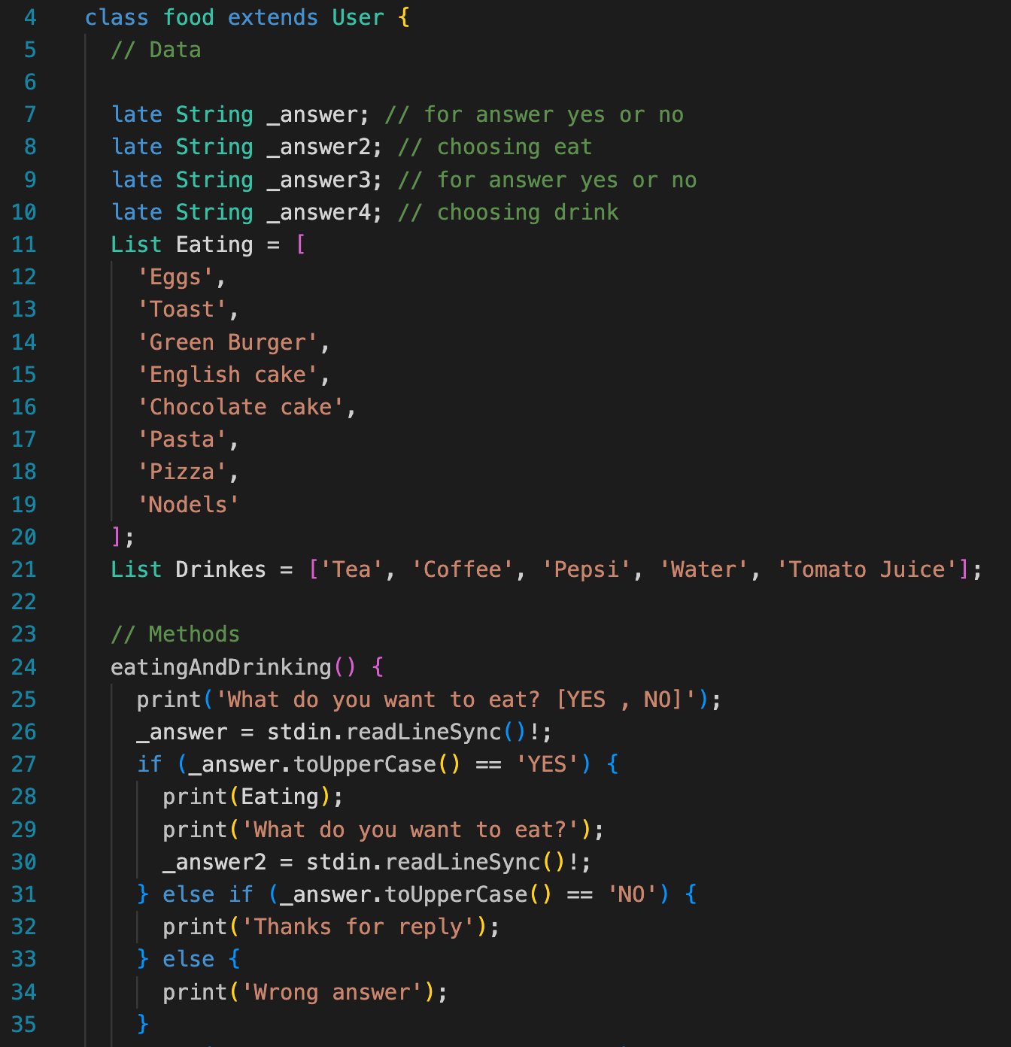

Class Food 1
14

Slide 15
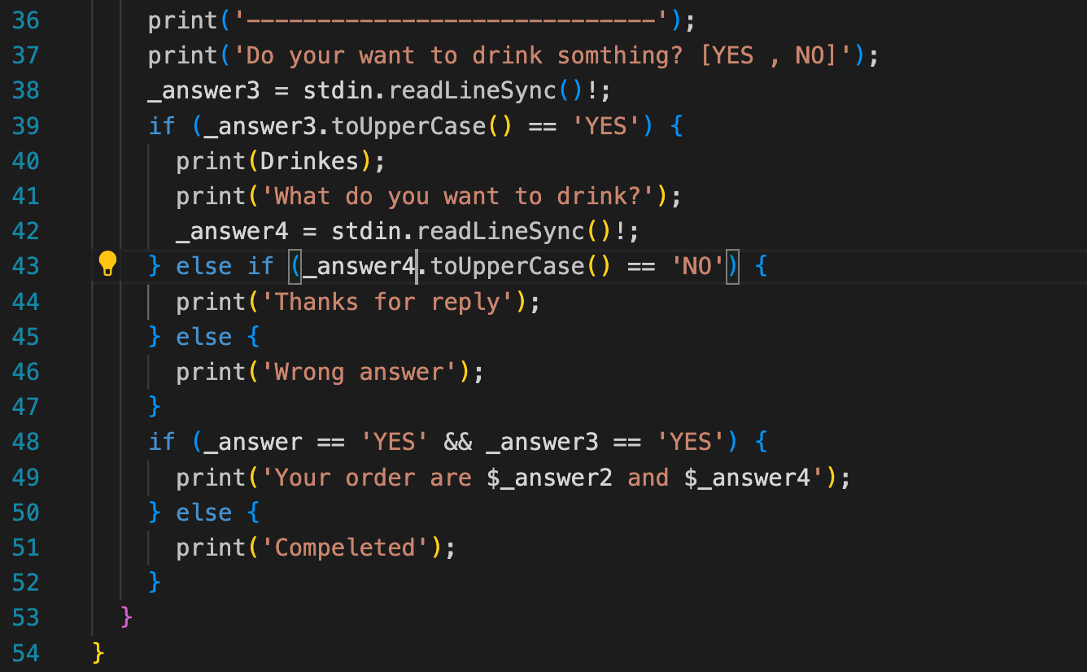
Class Food 2
15

Slide 16
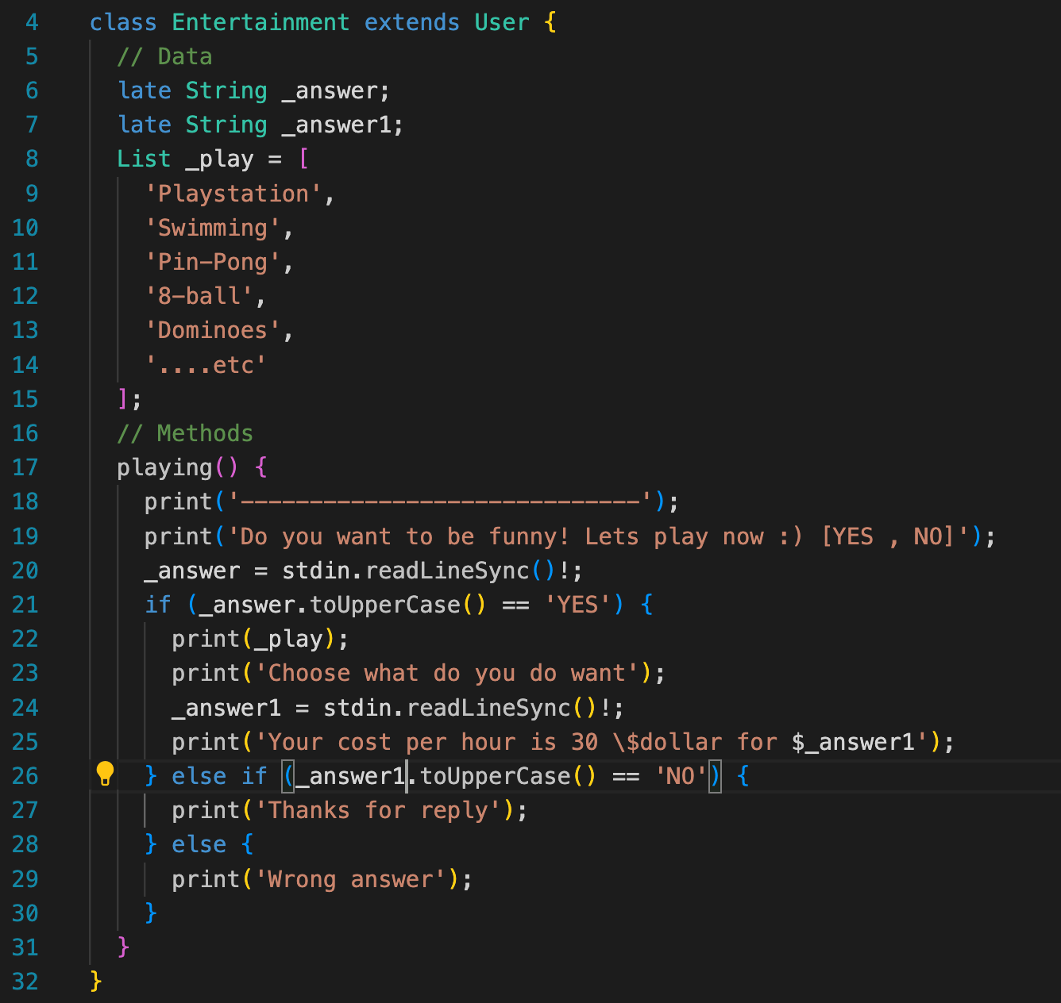

Class Entertainment
16

Slide 17
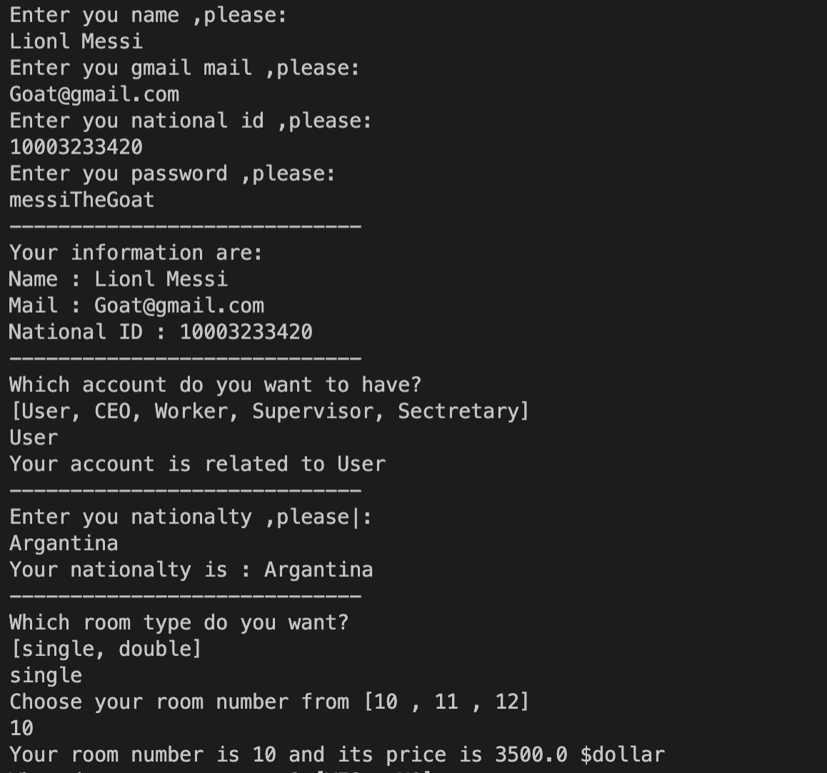

Class User Result 1
17

Slide 18
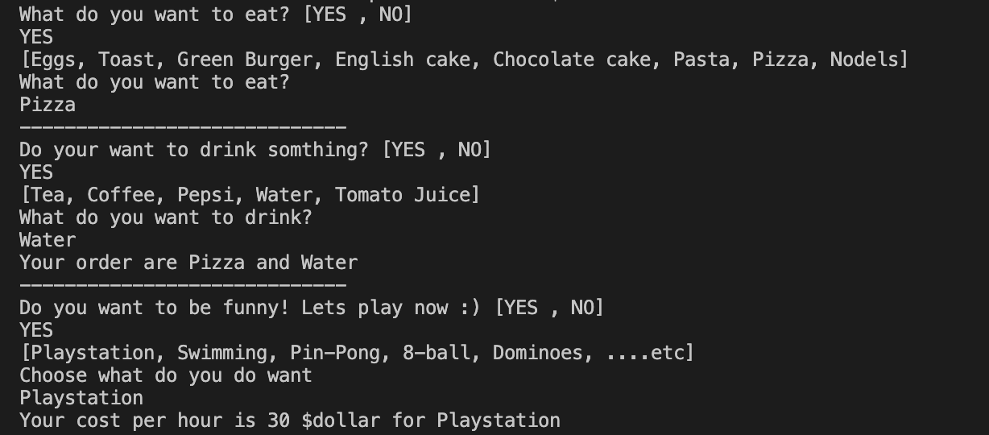
Class User Result 2
18

Slide 19

Thank you ☺
19

